Slide 1
Computer Algorithms (COS 101)
Week 2

Slide 2
Learning Objectives
What is an Algorithm?
Why do we need Algorithms?
Characteristics of a Good Algorithm
Advantages of Algorithm
Components of an Algorithm
Disadvantages of Algorithm
Benefits of an Algorithm
Representations of Algorithm

Slide 3

What is an Algorithm?

Slide 4

Other Definitions
1
A finite set of unambiguous instructions performed in a prescribed sequence to achieve a goal, especially a mathematical rule or procedure used to compute a desired result.
2
A predetermined set of instructions for solving a specific problem in a limited number of steps.
3
A precise step-by-step plan for a computational procedure that possibly begins with an input value and yields an output value in a finite number of steps.

Slide 5

Why do we need an Algorithm?
You use a computer algorithm to prepare a roadmap of the program to be written, before actually writing the code.
Algorithmic thinking allows you to break down problems and conceptualize solutions in terms of discrete steps.
Algorithmic thinking, or the ability to define clear steps to solve a problem, is crucial in many fields. Even if we’re not conscious of it, we use algorithms and algorithmic thinking all the time.
Being able to understand and implement an algorithm requires you to practice structured thinking and reasoning abilities.

Slide 6
Characteristics of a Good Algorithm
Precision:
Uniqueness:
Finiteness:
The steps are precisely stated or defined.
Results of each step are uniquely defined and only depend on the input and the result of the preceding steps.
The algorithm always stops after a finite number of steps.
Input:
The algorithm receives some input.
Output:
The algorithm produces some output.

Slide 7
Advantages of Algorithm
It is a step wise representation of a solution to a given problem, which makes it easier to understand.
An algorithm uses a definite procedure.
It is not dependent on any programming language, so it is easy to understand for anyone without programming knowledge.
Every step has its on logical sequence, so it is easy to debug
By using algorithm, the problem is broken down into smaller pieces or steps hence, it is easier for programmer to convert it into an actual program.

Slide 8
Components of an Algorithm
Input
The input to be taken from the user.
Processing or computation to be performed to get the desired result.
The output desired by the user.
Process
Output

Slide 9
Disadvantages of Algorithm
Algorithms is time consuming.
Difficult to show branching and looping in algorithms.
Big tasks are difficult to put in algorithms.
Complex problems cannot be solved.
Small solutions are not clearly shown.
Requires lots of data.
Low performance.

Slide 10
Benefits of Algorithms
In computers, an algorithm is very important when we want a specific set of instructions for performing a specific task that is definite.
It works well in automated and high-frequency trending systems.
Algorithms make people’s lives easier because they save slots of time for the things that are time taking if done manually.
In an algorithm the problem is divided into parts then it becomes easy to understand every level of the process with logic.

Slide 11
Representation of Algorithms
There are two common methods of representing an algorithm:
Flowcharts
Pseudocodes

Slide 12

Flowchart — Visual Representation of Algorithms
A flowchart is a diagram made up of boxes, diamonds and other shapes, connected by arrows.
Each shape represents a step of the solution process and the arrow represents the order or link among the steps.

Slide 13
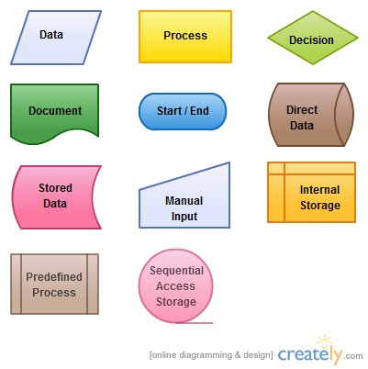
Flowchart — Visual Representation of Algorithms

Slide 14
Flowchart — Visual Representation of Algorithms
Algorithm to find square of a number
Start
Input num
square = num * num
Print square
Stop

Slide 15
Flowchart — Visual Representation of Algorithms
Start
Check bulb switch
Is the bulb switch on?
N
Switch On
A flowchart to solve the problem of a non-functioning light bulb
Y
Call Electrician
N
Bulb On?
Is it Burnt Out?
N
Y
Y
Replace the Bulb
Stop
Leave bulb On

Slide 16
Pseudocode
A pseudocode is another way of representing an algorithm.
It is considered as a non-formal language that helps programmers to write algorithm.
It is a detailed description of instructions that a computer must follow in a particular order.
It is intended for human reading and cannot be executed directly by the computer.
No specific standard for writing a pseudocode exists.

Slide 17
Pseudocode Example
Write an algorithm to calculate area and perimeter of a rectangle, using both pseudocode and flowchart.
Pseudocode for calculating area and perimeter of a rectangle
INPUT length INPUT breadth COMPUTE Area = length * breadth PRINT Area COMPUTE Perim = 2 * (length + breadth) PRINT Perim

Slide 18
Pseudocode
Some of the frequently used keywords while writing pseudocode:
INPUT
COMPUTE
PRINT
INCREMENT
DECREMENT
IF/ELSE
WHILE
TRUE/FALSE

Slide 19
The Flowchart
Start
Input length, breadth
Area = length * breadth
Print Area
Perim = 2 * (length + breadth)
Print Perim
Stop

Slide 20
Benefits of Pseudocode
Pseudocode helps in representing the basic functionality of the intended program.
By writing the code first in a human readable language, the programmer safeguards against leaving out any important step.
For non-programmers, actual programs are difficult to read and understand, but pseudocode helps them to review the steps to confirm that the proposed implementation is going to achieve the desire output.

